Slide 1
CONCEPTS AND PRINCPLES F PHARMACOLOGY AND THERAPEUTICS
Caroline Kanyingi
21/10/2020

Slide 2
The different types of drugs formulations and their respective advantages and disadvantages.
The various routes of drug administration and their respective advantages and disadvantages for specific therapeutic indications.
The various factors that affect drug absorption, drug distribution and drug excretion.
The role of receptors as targets for drug action and their role in the mediation of drug responses.
The fundamental difference between an agonist and antagonist.
The relationship between generic versions of drugs and their branded product.
The concept of drug bioavailability.
The essentials of the drug approval process.
The concept that in addition to beneficial clinical effects the use of drugs can also lead to toxic side effects

Slide 3
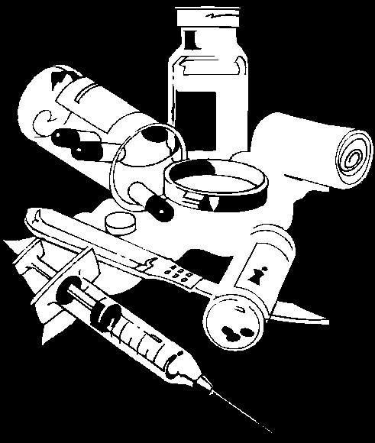
FOUR GOALS OF PHARMACOLOGY
Gain knowledge of various drug types
Describe forms in which medications are administered
Describe proper modes of administration
Recognize toxicity and overdose

Slide 4
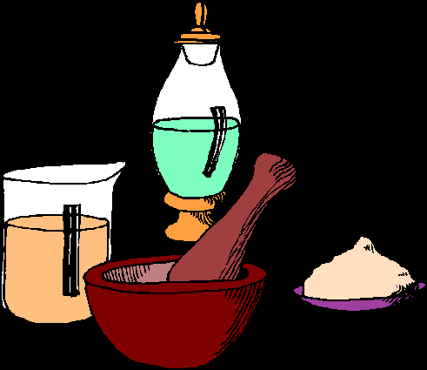
Historical Trends in Pharmacology
Ancient health care
Use of herbs and minerals to treat the sick and injured has been documented as long ago as 2000B.C.
Ancient Egyptians, Arabs, and Greeks passed formulations down through generations
17th and 18th centuries
Tinctures of opium, coca, and digitalis were available
1796 Edward Jenner’s smallpox inoculation

Slide 5

Historical Trends in Pharmacology
19th century
Atropine, chloroform, codeine, ether, and morphine were in use
20th century
Animal insulin and penicillin dramatically changed the treatment of endocrine and infectious diseases
The present
DNA technology
Human insulin
tPA
Many medications previously available only by prescription are now sold over-the-counter

Slide 6
Components of a Drug Profile
Name
Classification
Mechanism of Action
Indications
Pharmacokinetics
Side Effects/adverse reactions
Routes of Administration
Contraindications
Dosage
How Supplied
Special Considerations

Slide 7
Drug Effects
when a drug is used therapeutically, the desired action is termed the therapeutic effect
the effects of all drugs are dose-dependent
the amount of drug that is administered determines both qualitative and quantitative aspects of its effects
very low doses - no observable effects
high enough doses - toxic reactions

Slide 8
Side Effects
any other action is a side effect
side effects may be adverse, beneficial, or innocuous
adverse drug reactions include
toxic effects due to overmedication
common side effects that appear at therapeutic dosages
idiosyncratic side effects (e.g., allergic reactions) that are not clearly related to dose
side effects vary from mild to life-threatening
side effects may develop insidiously over a long period of time or may occur in an idiosyncratic and unpredictable fashion

Slide 9
Side Effects
Behavioral Effects
Agitation and Restlessness
Sedation
Impaired memory
Hostility, Disinhibition, Aggression
Switch Mania
Sleep disturbances
Withdrawal Reactions

Slide 10
Side Effects
Cardiovascular Effects
hypertensive reaction
orthostatic hypotension
cardiac conduction delays
Endocrine and Metabolic Effects
hyperprolactinemia
hypothyroidism
nephrogenic diabetes insipidus
hypercalcemia
weight gain

Slide 11
Side Effects
Hematologic Reactions
aplastic anemia
agranulocytosis
leukocytosis
eosinophilia
benign leukopenia
thrombocytopenia
Hepatic effects
changes in liver functions

Slide 12
Side Effects
Reproductive and Adverse Sexual Effects
changes in libido
priapism
impotence
ejaculatory disturbances
Renal and Genitourinary System Effects
polyuria
incontinence and enuresis
urinary retention
renal failure

Slide 13
Side Effects
Immunologic and Gastrointestinal Effects
xerostomia
dysphagia (may result in aspiration and asphyxiation)
gastroesophageal reflux
nausea, vomiting and GI discomfort
constipation or abnormal distension
diarrhea
Convulsive effects

Slide 14
Side Effects
Neuromuscular Effects
action (inaction) tremor of upper extremities
acute extrapyramidal symptoms (including dystonia, bradykinesia, akinesia, tremor, and rigidity)
neuroleptic malignant syndrome

Slide 15
Side Effects
General medication strategies to deal with side effects
Dosage reduction
Drug change
Adjunctive medication
Drug discontinuation

Slide 16
Standardization of Drugs
Standardization is a necessity
Techniques for measuring a drug’s strength and purity
Assay: test that determines the amount and purity of a given chemical in a preparation in the laboratory
Bioassay: test to ascertain a drug’s availability in a biological model
Bioequivalence: relative therapeutic effectiveness of chemically equivalent drugs

Slide 17
Investigational Drugs
Prospective drugs may take years to progress through the FDA testing sequence
Animal studies to ascertain
Toxicity
Therapeutic index
Ratio of a drugs lethal dose to its effective dose
Modes of absorption, distribution, metabolism (biotransformation), and excretion
Human studies

Slide 18
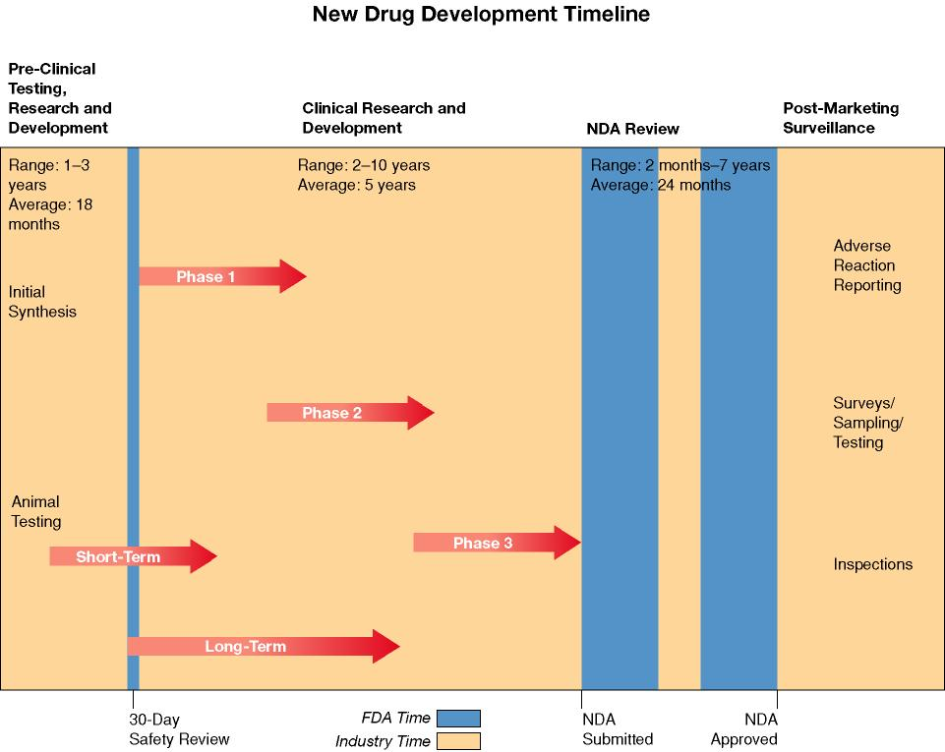
Investigational Drugs
FDA approval process
Phases of investigation (4 phases)
Phase 1: determines pharmacokinetics, toxicity, safe dose in humans
Phase 2: find therapeutic dose in target audience
Phase 3: refine therapeutic dose and determine side effects
Usually double blinded study
Phase 4: postmarketing analysis during conditional approval period

Slide 19
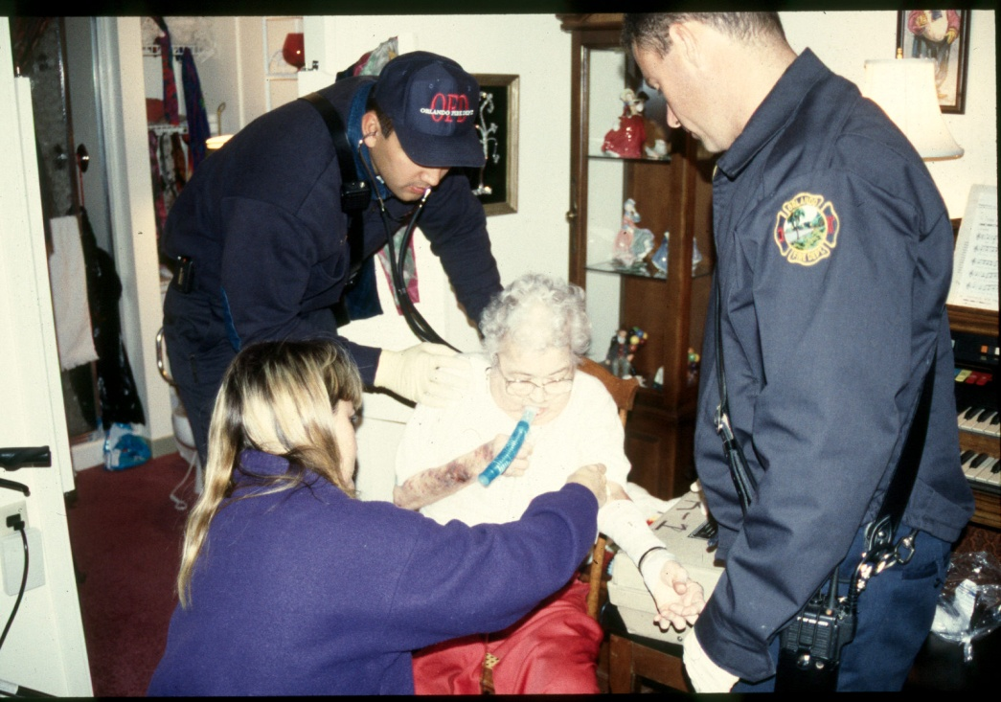
Six Rights of Medication Administration
Right medication
Right dose
Right time
Right route
Right patient
Right documentation

Slide 20
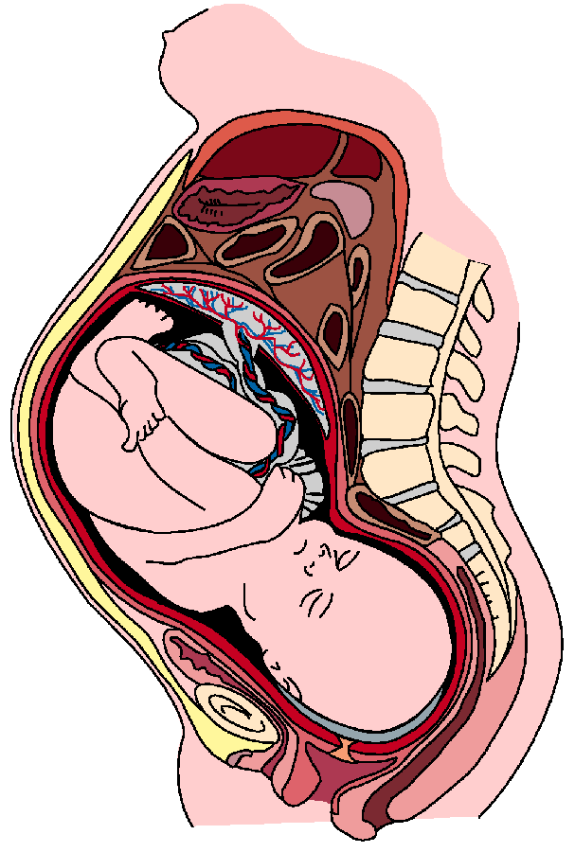

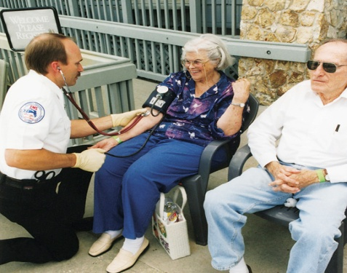
Special Considerations
Pregnant Patients
Pediatric Patients
Geriatric Patients

Slide 21
Special Considerations
Pregnant patients
Before using any drug during pregnancy, the expected benefits should be considered against the possible risks to the fetus
The FDA has established a scale (Categories A, B, C, D, and X) to indicate drugs that may have documented problems in animals and/or humans during pregnancy
Many drugs are unknown to cause problems in animals and/or human during pregnancy

Slide 22
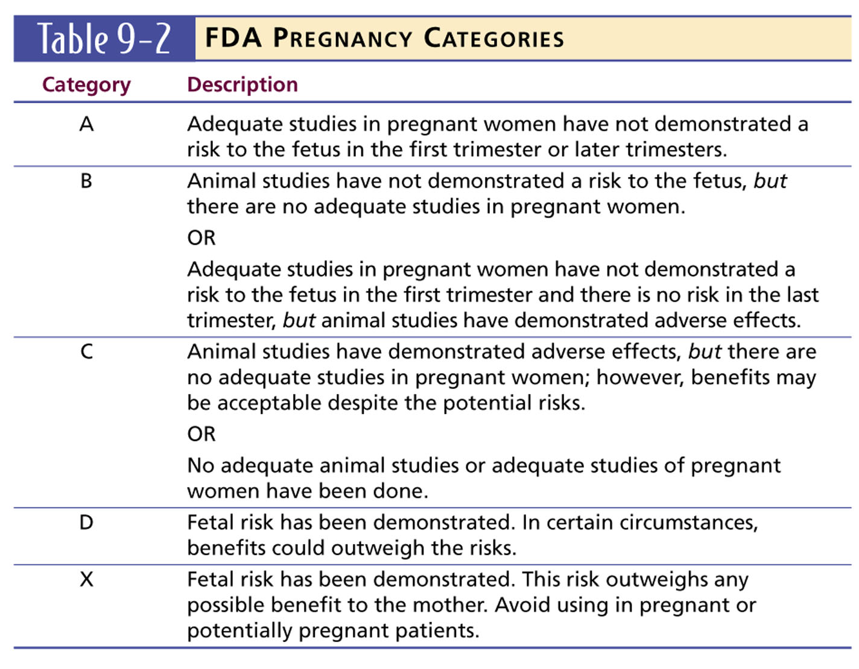

Slide 23
Special Considerations
Pregnant patients
Pregnancy causes a number of anatomical and physiological changes
Drugs may cross the placenta, during lactation
Fetus does not have a functioning blood brain barrier, so the volume of distribution is different
All medications will enter the baby’s brain

Slide 24
Pregnant Patients
Ask the patient if there is a possibility that she could be pregnant.
Some drugs may have an adverse effect on the fetus of a pregnant female.
Teratogenic drug…is a medication that may deform or kill the fetus.

Slide 25
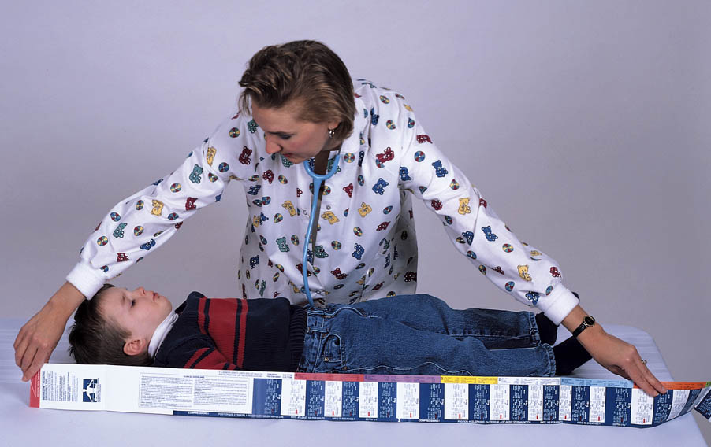
Special Considerations
Pediatric patients
Based on child’s weight or body surface area
Special concerns for neonates
Higher proportion of extracellular fluid (nearly 80%)
Less protein binding

Slide 26

Special Considerations
Geriatric patients
Physiological effects of aging can lead to altered pharmacodynamics and pharmacokinetics
Slower absorption of oral medications due to decrease in GI motility
Decreased plasma protein concentration
Body fat increases and muscle mass decreases (less absorption)
Decreased liver function may delay or prolong drug action
Polydrug use and medication interactions

Slide 27
Questons??

